Slide 1
FINANCIAL PERFORMANCE DASHBOARD
Domain: Business Analyst/Finance Analyst
Tool Used: Power BI
Dataset: Microsoft Financial Sample dataset
Project Level: Intermediate
Description:
Analyzes company financial performance using Power BI
Evaluates sales, profit, COGS, and discount impact
Supports data-driven business decision-making

Slide 2
PROBLEM STATEMENT
Business Problem:
Organizations need a clear understanding of their financial performance across countries, products, segments, and time periods.
Challenges Addressed:
Understanding the impact of discounts on profit
Tracking sales and profit trends over time
Identifying profitable segments and products
Comparing cost (COGS) vs revenue

Slide 3
PROJECT OBJECTIVES
Objectives:
Analyze total sales, profit, and COGS
Identify high-performing products and regions
Measure profit margin and YoY growth
Provide interactive insights using Power BI visuals

Slide 4
DATA PREPARATION
Steps Performed:
Imported dataset into Power BI
Cleaned and validated data
Created date hierarchy (Year, Month)
Verified numeric and categorical fields
Key Tables Used:
Sales fact data
Product, Country, Segment dimensions
Purpose:
To ensure data accuracy, consistency, and analytical reliability.

Slide 5
CALCULATIONS & KPIS (DAX)
Key Measures Created:
Total Sales=SUM('FACT_ SALES'[Sales])
Total Profit=SUM('FACT_ SALES'[Profit])
Total COGS=SUM('FACT_ SALES'[COGS])
Profit Margin %=DIVIDE([TOTAL_PROFIT],[TOTAL_SALES],0)
Sales YTD=TOTALYTD([TOTAL_SALES],'DIM_DATE'[Date])
Year-over-Year Growth=DIVIDE([TOTAL_SALES]-[SALES LY],[SALES LY],0)
COGS Ratio=DIVIDE([TOTAL_COGTOTAL_SALES],0)
Purpose:
To convert raw data into meaningful financial metrics.

Slide 6
VISUALIZATION TECHNIQUES
Visuals Used:
KPI Cards
Bar Charts
Line Charts
Scatter Plots
Waterfall Chart
Matrix Table
Interactivity:
Slicers (Country, Segment, Year, Product)
Drill-down analysis
Clear slicer button

Slide 7
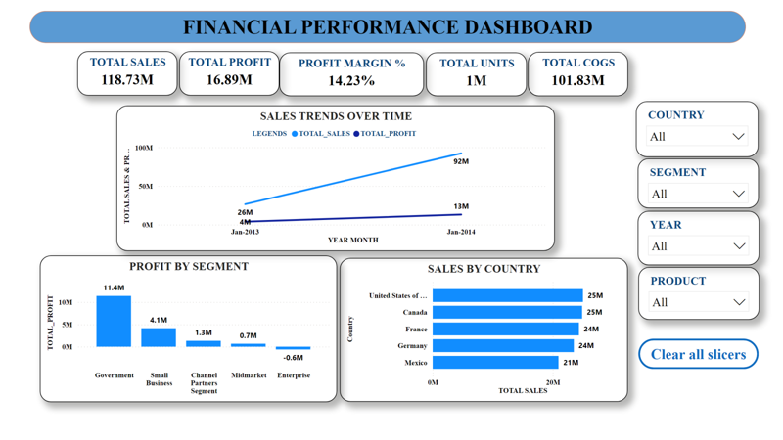
Dashboard Highlights:
Overall financial summary
Key KPIs displayed at the top
Interactive filters for dynamic analysis
Purpose:
Enable quick executive-level understanding and decision-making.

Slide 8
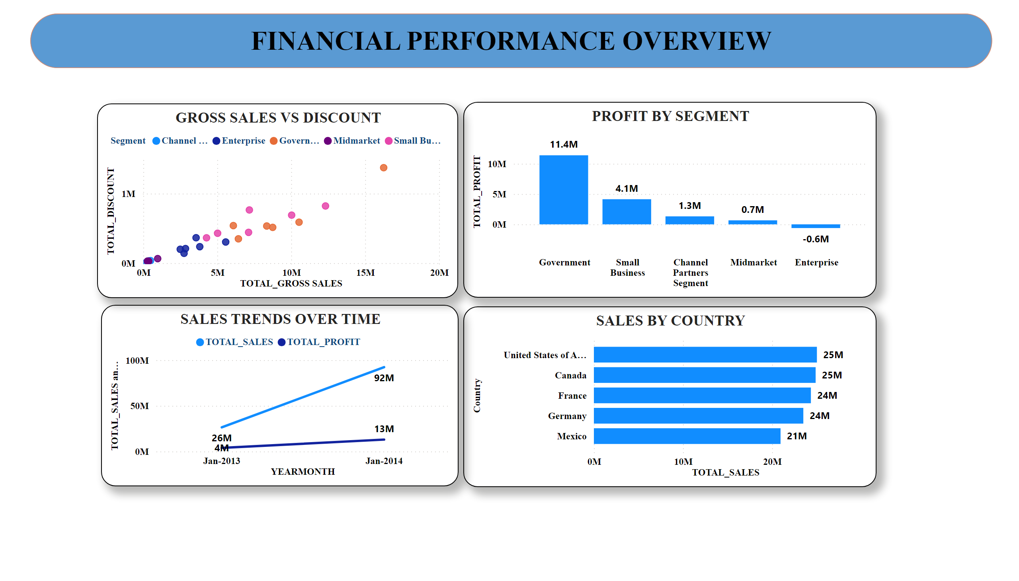
Insights:
Government and Small Business segments generate higher profits
Discounts directly affect profit margins
Sales trend shows consistent growth over time

Slide 9
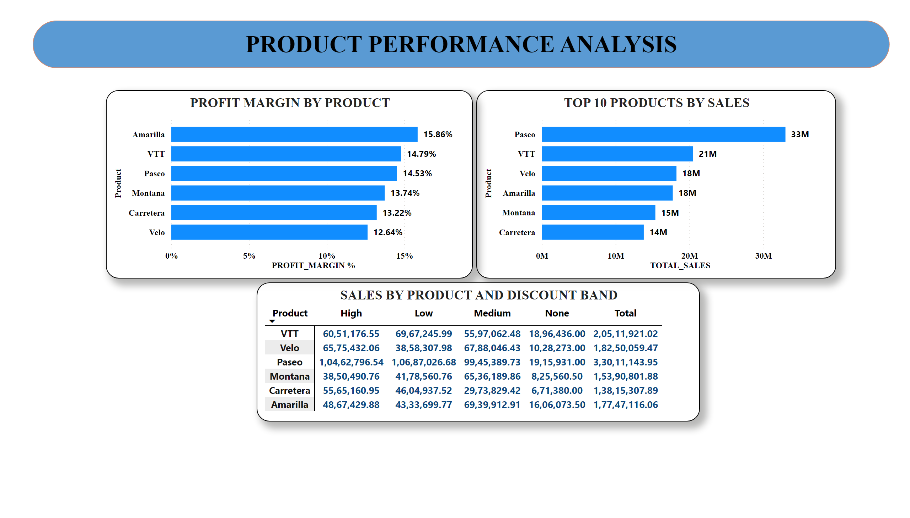
Insights:
Amarilla and Paseo have higher profit margins
Top products contribute major share of revenue
Discount bands significantly impact product sales

Slide 10
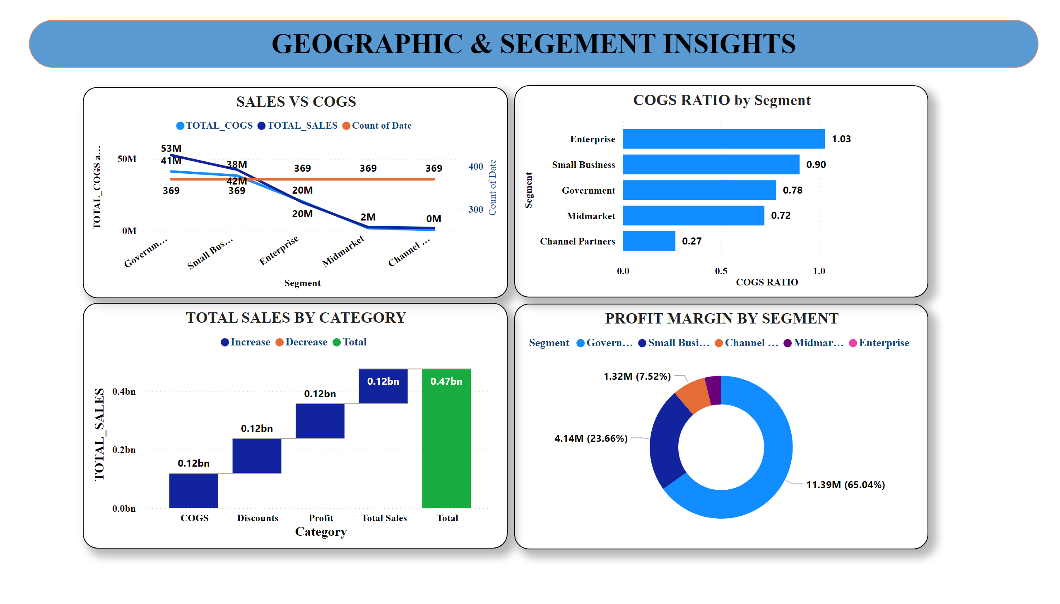
Insights:
USA and Canada are top revenue contributors
Enterprise segment shows higher COGS ratio
Channel Partners maintain better cost efficiency

Slide 11
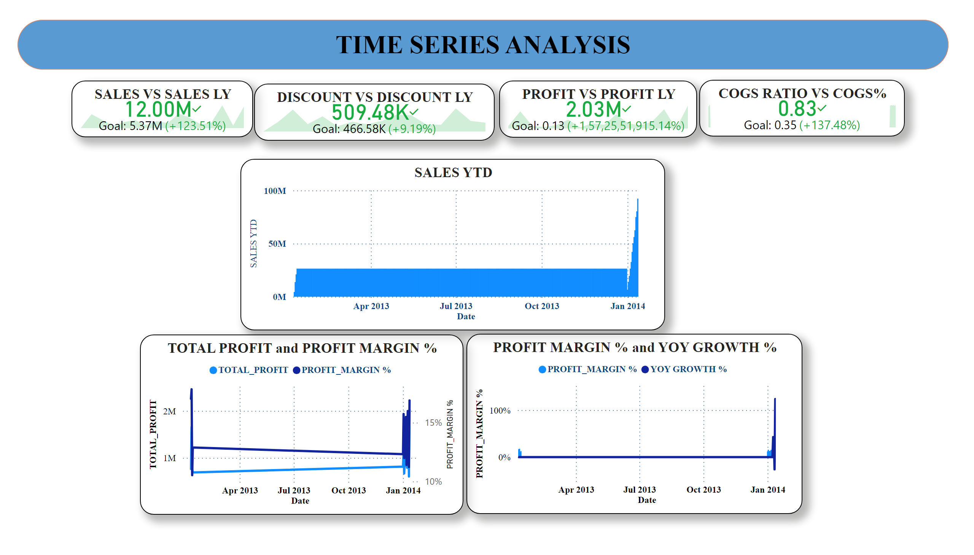
Insights:
Sales and profit show positive YoY growth
YTD sales steadily increase across months
Profit margin remains stable with seasonal variation

Slide 12
KEY FINDINGS
Key Findings:
Government segment is the most profitable contributor
Certain products yield high margins but lower sales volume
Discount optimization is critical to protect profitability

Slide 13
CONCLUSION & FUTURE SCOPE
Conclusion:
Power BI dashboard provides clear financial visibility
Helps stakeholders make informed decisions
Future Enhancements:
Forecasting models
Advanced profitability scenarios
Integration with real-time data

Slide 14
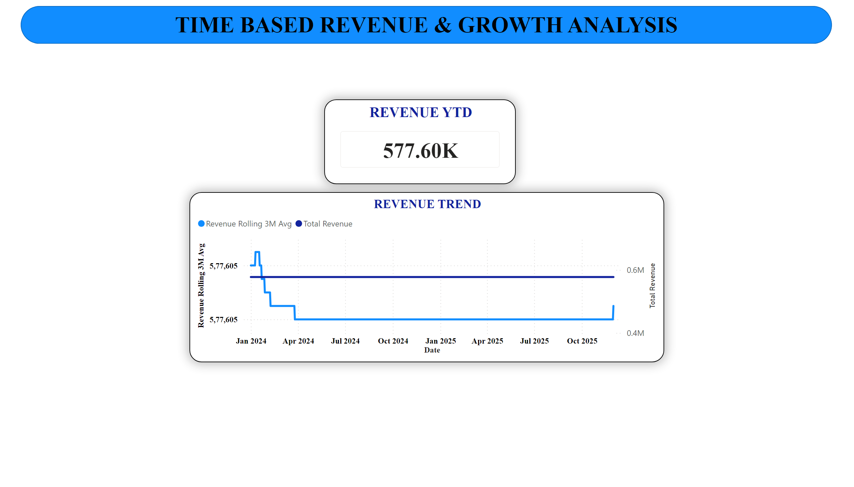
Insights:
Revenue YTD: 577.60K
Rolling 3-month revenue trends
Stable revenue pattern with minor fluctuations
Business Insight:
Helps track growth patterns and seasonality over time

